Slide 1
Basic Concepts of MySQL
(15 hours)
Notes:
Title - The learning outcome
Subtitle - Duration

Slide 2
In this section, we will discuss:
Understanding MySQL database
MySQL syntax and semantics
MySQL DDL
MySQL DML
MySQL Transaction Control
MySQL User Management
MySQL Security aspects
MySQL Query execution
MySQL query optimization
•MySQL Complex queries
Notes:
Mention the parent topics one by one. This particular learning outcome has 4 parent topics.

Slide 3
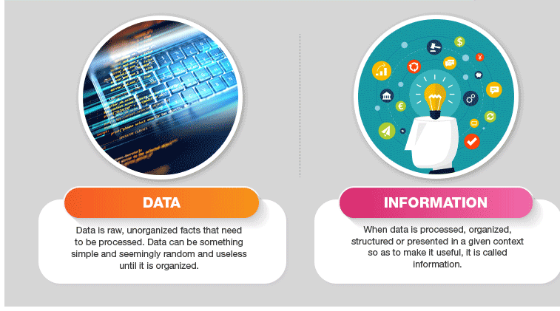
Understanding MySQL database
What is Data?
In simple words, data can be facts related to any object in consideration. For example, your name, age, height, weight, etc. are some data related to you. A picture, image, file, pdf, etc. can also be considered data.
Image Source: https://cdn1.byjus.com/wp-content/uploads/2018/12/Difference-between-data-and-information.png
Notes:
Left (White Color space):
Title - Parent Topic
Subtitle - Subtopic 1
Body Text - Description in bullets
Right (Grey Color Space):
Body Text - Relevant image (with source)/code snippet
Put reference links in Speaker Notes
Reference:
https://www.tutorialspoint.com/internet_technologies/internet_overview.htm/

Slide 4

Unstructured databases
What is Database?
A database is a systematic collection of data. They support electronic storage and manipulation of data. Databases make data management easy.
Image Source: https://thehackernews.com/images/-OcSr8sT_hgU/YW2Z63xmaXI/AAAAAAAABSw/m1tSHwEr1gkl6UDNOIrSGYIgL1pwToyQgCLcBGAsYHQ/s0/patch.png
Notes:
Left (White Color space):
Title - Parent Topic
Subtitle - Subtopic 1
Body Text - Description in bullets
Right (Grey Color Space):
Body Text - Relevant image (with source)/code snippet
Put reference links in Speaker Notes
Reference:
https://www.tutorialspoint.com/internet_technologies/internet_overview.htm/

Slide 5
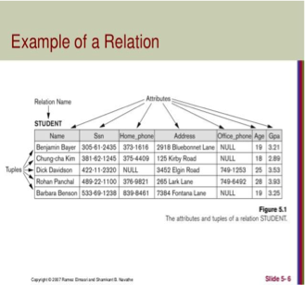
Relational Data Structure
Relational Model Concepts
Attribute: The properties which define a relation.
Tables: Relations are saved in the table format.
Tuple: Single row of a table
Relation Schema: Represents the name of the relation with its attributes.
Image Source :https://www.slideshare.net/kumar_vic/4-the-relational-data-model-and-relational-database-constraints
Notes:
Left (White Color space):
Title - Parent Topic
Subtitle - Subtopic 1
Body Text - Description in bullets
Right (Grey Color Space):
Body Text - Relevant image (with source)/code snippet
Put reference links in Speaker Notes
Reference:
https://www.tutorialspoint.com/internet_technologies/internet_overview.htm/

Slide 6
Relational Data Structure
Relational Model Concepts
Degree: The total number of attributes which in the relation.
Cardinality: Total number of rows present in the Table.
Column: Represents the set of values for a specific attribute.
Relation Instance: Is a finite set of tuples in the RDBMS system
Image Source :https://www.slideshare.net/kumar_vic/4-the-relational-data-model-and-relational-database-constraints
Notes:
Left (White Color space):
Title - Parent Topic
Subtitle - Subtopic 1
Body Text - Description in bullets
Right (Grey Color Space):
Body Text - Relevant image (with source)/code snippet
Put reference links in Speaker Notes
Reference:
https://www.tutorialspoint.com/internet_technologies/internet_overview.htm/

Slide 7
Relational Data Structure
Relational Model Concepts
Relation key: Every row has one, two or multiple attributes , which is called relation key.
Attribute domain: Every attribute has some pre-defined value and scope which is known as attribute domain.
Image Source :https://www.slideshare.net/kumar_vic/4-the-relational-data-model-and-relational-database-constraints
Notes:
Left (White Color space):
Title - Parent Topic
Subtitle - Subtopic 1
Body Text - Description in bullets
Right (Grey Color Space):
Body Text - Relevant image (with source)/code snippet
Put reference links in Speaker Notes
Reference:
https://www.tutorialspoint.com/internet_technologies/internet_overview.htm/

Slide 8
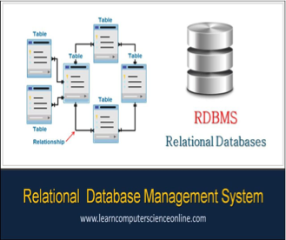
Relational Data Structure
Relational Integrity constraint
Advantages
Simplicity: Simpler than the hierarchical and network model.
Structural Independence: Is only concerned with data and not with a structure.
Easy to use: is easy as tables consisting of rows and columns is quite natural and simple to understand
Image Source :https://www.slideshare.net/kumar_vic/4-the-relational-data-model-and-relational-database-constraints
Notes:
Left (White Color space):
Title - Parent Topic
Subtitle - Subtopic 1
Body Text - Description in bullets
Right (Grey Color Space):
Body Text - Relevant image (with source)/code snippet
Put reference links in Speaker Notes
Reference:
https://www.tutorialspoint.com/internet_technologies/internet_overview.htm/

Slide 9
Relational Data Structure
Relational Integrity constraint
Advantages
Query capability: It makes possible for a high-level query language like SQL to avoid complex database navigation.
Data independence: The structure of a database can be changed without having to change any application.
Scalable: Regarding a number of records, or rows, and the number of fields, a database should be enlarged to enhance its usability.
Image Source :https://www.slideshare.net/kumar_vic/4-the-relational-data-model-and-relational-database-constraints
Notes:
Left (White Color space):
Title - Parent Topic
Subtitle - Subtopic 1
Body Text - Description in bullets
Right (Grey Color Space):
Body Text - Relevant image (with source)/code snippet
Put reference links in Speaker Notes
Reference:
https://www.tutorialspoint.com/internet_technologies/internet_overview.htm/

Slide 10
Relational Data Structure
Relational Integrity constraint
Disadvantages
Few relational databases have limits on field lengths which can't be exceeded.
Can sometimes become complex as the amount of data grows, and the relations between pieces of data become more complicated.
Image Source :https://www.slideshare.net/kumar_vic/4-the-relational-data-model-and-relational-database-constraints
Notes:
Left (White Color space):
Title - Parent Topic
Subtitle - Subtopic 1
Body Text - Description in bullets
Right (Grey Color Space):
Body Text - Relevant image (with source)/code snippet
Put reference links in Speaker Notes
Reference:
https://www.tutorialspoint.com/internet_technologies/internet_overview.htm/

Slide 11
Relational Data Structure
Relational Integrity constraint
Disadvantages
Complex relational database systems may lead to isolated databases where the information cannot be shared from one system to another.
Image Source :https://www.slideshare.net/kumar_vic/4-the-relational-data-model-and-relational-database-constraints
Notes:
Left (White Color space):
Title - Parent Topic
Subtitle - Subtopic 1
Body Text - Description in bullets
Right (Grey Color Space):
Body Text - Relevant image (with source)/code snippet
Put reference links in Speaker Notes
Reference:
https://www.tutorialspoint.com/internet_technologies/internet_overview.htm/

Slide 12
Keys and Relational Data Manipulation
Notes:
Title - The learning outcome
Subtitle - Duration

Slide 13
Types Keys in Database
Types of keys
Primary
Foreign
Super
Candidate
Unique
Keys
Key is an attribute or set of an attribute which helps to identify a row in a relation
Allows to find the relation between two tables.
Keys help you uniquely identify a row in a table
Used to establish and identify relationships between tables.
Image Source: https://cdn.ttgtmedia.com/rms/onlineImages/business_analytics-unstructured_data_mobile.png
Notes:
Left (White Color space):
Title - Parent Topic
Subtitle - Subtopic 1
Body Text - Description in bullets
Right (Grey Color Space):
Body Text - Relevant image (with source)/code snippet
Put reference links in Speaker Notes
Reference:
https://www.tutorialspoint.com/internet_technologies/internet_overview.htm/

Slide 14
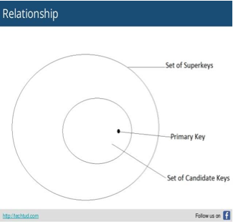
Types Keys in Database
Keys
Super key
A Super key is a group of single or multiple keys which identifies rows in a table.
A Super key may have additional attributes that are not needed for unique identification
Image Source: https://www.slideshare.net/TechtudNetwork/relation-between-super-key-candidate-key-and-primary . All rights reserved.
Notes:
Left (White Color space):
Title - Parent Topic
Subtitle - Subtopic 1
Body Text - Description in bullets
Right (Grey Color Space):
Body Text - Relevant image (with source)/code snippet
Put reference links in Speaker Notes
Reference:
https://www.tutorialspoint.com/internet_technologies/internet_overview.htm/

Slide 15
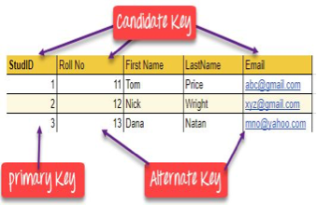
Types Keys in Database
Keys
Primary Key:
Is a column or group of columns in a table that uniquely identify every row in that table.
Can't be a duplicate.
A table cannot have more than one primary key.
Image Source: https://www.guru99.com/dbms-keys.htm
Notes:
Left (White Color space):
Title - Parent Topic
Subtitle - Subtopic 1
Body Text - Description in bullets
Right (Grey Color Space):
Body Text - Relevant image (with source)/code snippet
Put reference links in Speaker Notes
Reference:
https://www.tutorialspoint.com/internet_technologies/internet_overview.htm/

Slide 16
Types Keys in Database
Keys
Alternate key:
Is a column or group of columns in a table that uniquely identify every row in that table.
A table can have multiple choices for a primary key but only one can be set as the primary key.
All the keys which are not primary key are called an Alternate Key.
Image Source: https://www.guru99.com/dbms-keys.htm
Notes:
Left (White Color space):
Title - Parent Topic
Subtitle - Subtopic 1
Body Text - Description in bullets
Right (Grey Color Space):
Body Text - Relevant image (with source)/code snippet
Put reference links in Speaker Notes
Reference:
https://www.tutorialspoint.com/internet_technologies/internet_overview.htm/

Slide 17
Types Keys in Database
Keys
Candidate Key:
Is a set of attributes that uniquely identify tuples in a table.
Is a super key with no repeated attributes.
The Primary key should be selected from the candidate keys.
Every table must have at least a single candidate key.
Image Source: https://www.guru99.com/dbms-keys.htm
Notes:
Left (White Color space):
Title - Parent Topic
Subtitle - Subtopic 1
Body Text - Description in bullets
Right (Grey Color Space):
Body Text - Relevant image (with source)/code snippet
Put reference links in Speaker Notes
Reference:
https://www.tutorialspoint.com/internet_technologies/internet_overview.htm/

Slide 18
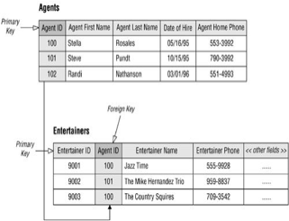
Types Keys in Database
Keys
Foreign key:
Is a column that creates a relationship between two tables.
The purpose of Foreign keys is to maintain data integrity
And allow navigation between two different instances of an entity.
It acts as a cross-reference between two tables
Image Source: http://etutorials.org/SQL/Database+design+for+mere+mortals/Part+I+Relational+Database+Design/Chapte
Notes:
Left (White Color space):
Title - Parent Topic
Subtitle - Subtopic 1
Body Text - Description in bullets
Right (Grey Color Space):
Body Text - Relevant image (with source)/code snippet
Put reference links in Speaker Notes
Reference:
https://www.tutorialspoint.com/internet_technologies/internet_overview.htm/

Slide 19
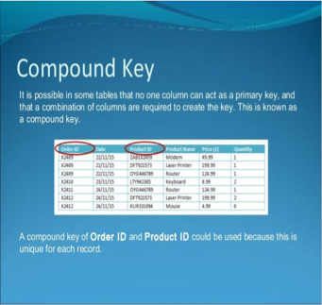
Types Keys in Database
Keys
Compound key:
Has two or more attributes that allow you to uniquely recognize a specific record.
The purpose of compound key is to uniquely identify each record in the table.
Image Source: https://www.slideshare.net/cunniman/database-keys
Notes:
Left (White Color space):
Title - Parent Topic
Subtitle - Subtopic 1
Body Text - Description in bullets
Right (Grey Color Space):
Body Text - Relevant image (with source)/code snippet
Put reference links in Speaker Notes
Reference:
https://www.tutorialspoint.com/internet_technologies/internet_overview.htm/

Slide 20
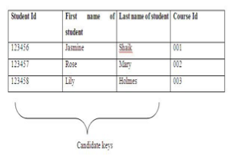
Types Keys in Database
Keys
Composite key:
Is a combination of two or more columns that uniquely identify rows in a table.
The combination of columns guarantees uniqueness, though individually uniqueness is not guaranteed.
Hence, they are combined to uniquely identify records in a table
Image Source: https://whatisdbms.com/wp-content/uploads/2016/06/Candidate-Key.jpg
Notes:
Left (White Color space):
Title - Parent Topic
Subtitle - Subtopic 1
Body Text - Description in bullets
Right (Grey Color Space):
Body Text - Relevant image (with source)/code snippet
Put reference links in Speaker Notes
Reference:
https://www.tutorialspoint.com/internet_technologies/internet_overview.htm/

Slide 21
Types Keys in Database
Keys
Compound v/s composite key
The difference between compound and the composite key is that any part of the compound key can be a foreign key, but the composite key may or maybe not a part of the foreign key.
Image Source: https://whatisdbms.com/wp-content/uploads/2016/06/Candidate-Key.jpg
Notes:
Left (White Color space):
Title - Parent Topic
Subtitle - Subtopic 1
Body Text - Description in bullets
Right (Grey Color Space):
Body Text - Relevant image (with source)/code snippet
Put reference links in Speaker Notes
Reference:
https://www.tutorialspoint.com/internet_technologies/internet_overview.htm/

Slide 22
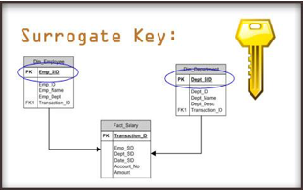
Types Keys in Database
Keys
Surrogate Key:
An artificial key which aims to uniquely identify each record is called a surrogate key.
These kind of key are unique because they are created when you don't have any natural primary key
They do not lend any meaning to the data in the table.
Surrogate key is usually an integer.
Image Source: https://www.studytonight.com/dbms/database-key.php
Notes:
Left (White Color space):
Title - Parent Topic
Subtitle - Subtopic 1
Body Text - Description in bullets
Right (Grey Color Space):
Body Text - Relevant image (with source)/code snippet
Put reference links in Speaker Notes
Reference:
https://www.tutorialspoint.com/internet_technologies/internet_overview.htm/

Slide 23
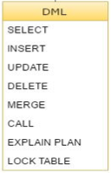
Relational Data Manipulation
Data Manipulation Language (DML)
DML stands for Data Manipution Language. It is used for accessing and manipulating data in a database.
It handles user requests.
Image Source: https://www.studytonight.com/dbms/database-key.php
Notes:
Left (White Color space):
Title - Parent Topic
Subtitle - Subtopic 1
Body Text - Description in bullets
Right (Grey Color Space):
Body Text - Relevant image (with source)/code snippet
Put reference links in Speaker Notes
Reference:
https://www.tutorialspoint.com/internet_technologies/internet_overview.htm/

Slide 24
Relational Data Manipulation
Data Manipulation Language (DML)
Here are some tasks that come under DML:
Select: It is used to retrieve data from a database.
Insert: It is used to insert data into a table.
Image Source: https://www.studytonight.com/dbms/database-key.php
Notes:
Left (White Color space):
Title - Parent Topic
Subtitle - Subtopic 1
Body Text - Description in bullets
Right (Grey Color Space):
Body Text - Relevant image (with source)/code snippet
Put reference links in Speaker Notes
Reference:
https://www.tutorialspoint.com/internet_technologies/internet_overview.htm/

Slide 25
Relational Data Manipulation
Data Manipulation Language (DML)
Here are some tasks that come under DML:
Update: It is used to update existing data within a table.
Delete: It is used to delete all records from a table.
Merge: It performs UPSERT operation, i.e., insert or update operations.
Image Source: https://www.studytonight.com/dbms/database-key.php
Notes:
Left (White Color space):
Title - Parent Topic
Subtitle - Subtopic 1
Body Text - Description in bullets
Right (Grey Color Space):
Body Text - Relevant image (with source)/code snippet
Put reference links in Speaker Notes
Reference:
https://www.tutorialspoint.com/internet_technologies/internet_overview.htm/

Slide 26
Relational Data Manipulation
Data Manipulation Language (DML)
Here are some tasks that come under DML:
Call: It is used to call a structured query language or a Java subprogram.
Explain Plan: It has the parameter of explaining data.
Lock Table: It controls concurrency.
Image Source: https://www.studytonight.com/dbms/database-key.php
Notes:
Left (White Color space):
Title - Parent Topic
Subtitle - Subtopic 1
Body Text - Description in bullets
Right (Grey Color Space):
Body Text - Relevant image (with source)/code snippet
Put reference links in Speaker Notes
Reference:
https://www.tutorialspoint.com/internet_technologies/internet_overview.htm/

Slide 27
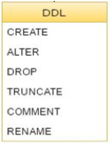
Data Definition Language
DDL
DDL actually consists of the SQL commands that can be used to define the database schema.
It simply deals with descriptions of the database schema.
And is used to create and modify the structure of database objects in the database.
Image Source: https://www.studytonight.com/dbms/database-key.php
Notes:
Left (White Color space):
Title - Parent Topic
Subtitle - Subtopic 1
Body Text - Description in bullets
Right (Grey Color Space):
Body Text - Relevant image (with source)/code snippet
Put reference links in Speaker Notes
Reference:
https://www.tutorialspoint.com/internet_technologies/internet_overview.htm/

Slide 28
Data Definition Language
DDL
Examples of DDL commands
CREATE – is used to create the database or its objects
DROP – is used to delete objects from the database.
ALTER -is used to alter the structure of the database
Image Source: https://www.studytonight.com/dbms/database-key.php
Notes:
Left (White Color space):
Title - Parent Topic
Subtitle - Subtopic 1
Body Text - Description in bullets
Right (Grey Color Space):
Body Text - Relevant image (with source)/code snippet
Put reference links in Speaker Notes
Reference:
https://www.tutorialspoint.com/internet_technologies/internet_overview.htm/

Slide 29
Data Definition Language
DDL
Examples of DDL commands
TRUNCATE –is used to remove all records from a table, including all spaces allocated for the records are removed.
COMMENT –is used to add comments to the data dictionary.
RENAME –is used to rename an object existing in the database.
Image Source: https://www.studytonight.com/dbms/database-key.php
Notes:
Left (White Color space):
Title - Parent Topic
Subtitle - Subtopic 1
Body Text - Description in bullets
Right (Grey Color Space):
Body Text - Relevant image (with source)/code snippet
Put reference links in Speaker Notes
Reference:
https://www.tutorialspoint.com/internet_technologies/internet_overview.htm/

Slide 30
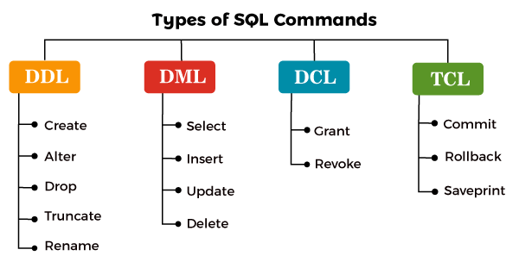
Data Control Language
DCL
DCL commands are used to grant and take back authority from any database user.
Here are some commands that come under DCL:
Grant
Revoke
Image Source: https://static.javatpoint.com/sqlpages/images/types-of-sql-commands.png
Notes:
Left (White Color space):
Title - Parent Topic
Subtitle - Subtopic 1
Body Text - Description in bullets
Right (Grey Color Space):
Body Text - Relevant image (with source)/code snippet
Put reference links in Speaker Notes
Reference:
https://www.tutorialspoint.com/internet_technologies/internet_overview.htm/

Slide 31
Data Control Language
DCL
Grant: It is used to give user access privileges to a database.
Example
GRANT SELECT, UPDATE ON MY_TABLE TO SOME_USER, ANOTHER_USER;
Image Source: https://static.javatpoint.com/sqlpages/images/types-of-sql-commands.png
Notes:
Left (White Color space):
Title - Parent Topic
Subtitle - Subtopic 1
Body Text - Description in bullets
Right (Grey Color Space):
Body Text - Relevant image (with source)/code snippet
Put reference links in Speaker Notes
Reference:
https://www.tutorialspoint.com/internet_technologies/internet_overview.htm/

Slide 32
Data Control Language
DCL
Revoke: It is used to take back permissions from the user.
Example
REVOKE SELECT, UPDATE ON MY_TABLE FROM USER1, USER2;
Image Source: https://static.javatpoint.com/sqlpages/images/types-of-sql-commands.png
Notes:
Left (White Color space):
Title - Parent Topic
Subtitle - Subtopic 1
Body Text - Description in bullets
Right (Grey Color Space):
Body Text - Relevant image (with source)/code snippet
Put reference links in Speaker Notes
Reference:
https://www.tutorialspoint.com/internet_technologies/internet_overview.htm/

Slide 33
Transaction Control Language
TCL
TCL commands can only use with DML commands like INSERT, DELETE and UPDATE only.
These operations are automatically committed in the database that's why they cannot be used while creating tables or dropping them.
Here are some commands that come under TCL:
COMMIT
ROLLBACK
SAVEPOINT
Image Source: https://static.javatpoint.com/sqlpages/images/types-of-sql-commands.png
Notes:
Left (White Color space):
Title - Parent Topic
Subtitle - Subtopic 1
Body Text - Description in bullets
Right (Grey Color Space):
Body Text - Relevant image (with source)/code snippet
Put reference links in Speaker Notes
Reference:
https://www.tutorialspoint.com/internet_technologies/internet_overview.htm/

Slide 34
Transaction Control Language
TCL
Commit: Commit command is used to save all the transactions to the database.
Syntax:
COMMIT;
Example:
DELETE FROM CUSTOMERS
WHERE AGE = 25;
COMMIT;
Image Source: https://static.javatpoint.com/sqlpages/images/types-of-sql-commands.png
Notes:
Left (White Color space):
Title - Parent Topic
Subtitle - Subtopic 1
Body Text - Description in bullets
Right (Grey Color Space):
Body Text - Relevant image (with source)/code snippet
Put reference links in Speaker Notes
Reference:
https://www.tutorialspoint.com/internet_technologies/internet_overview.htm/

Slide 35
Transaction Control Language
TCL
Rollback: Rollback command is used to undo transactions that have not already been saved to the database.
Syntax:
ROLLBACK;
Example:
DELETE FROM CUSTOMERS
WHERE AGE = 25;
ROLLBACK;
Image Source: https://static.javatpoint.com/sqlpages/images/types-of-sql-commands.png
Notes:
Left (White Color space):
Title - Parent Topic
Subtitle - Subtopic 1
Body Text - Description in bullets
Right (Grey Color Space):
Body Text - Relevant image (with source)/code snippet
Put reference links in Speaker Notes
Reference:
https://www.tutorialspoint.com/internet_technologies/internet_overview.htm/

Slide 36
Transaction Control Language
TCL
SAVEPOINT: It is used to roll the transaction back to a certain point without rolling back the entire transaction.
Syntax:
SAVEPOINT SAVEPOINT_NAME;
Image Source: https://static.javatpoint.com/sqlpages/images/types-of-sql-commands.png
Notes:
Left (White Color space):
Title - Parent Topic
Subtitle - Subtopic 1
Body Text - Description in bullets
Right (Grey Color Space):
Body Text - Relevant image (with source)/code snippet
Put reference links in Speaker Notes
Reference:
https://www.tutorialspoint.com/internet_technologies/internet_overview.htm/

Slide 37
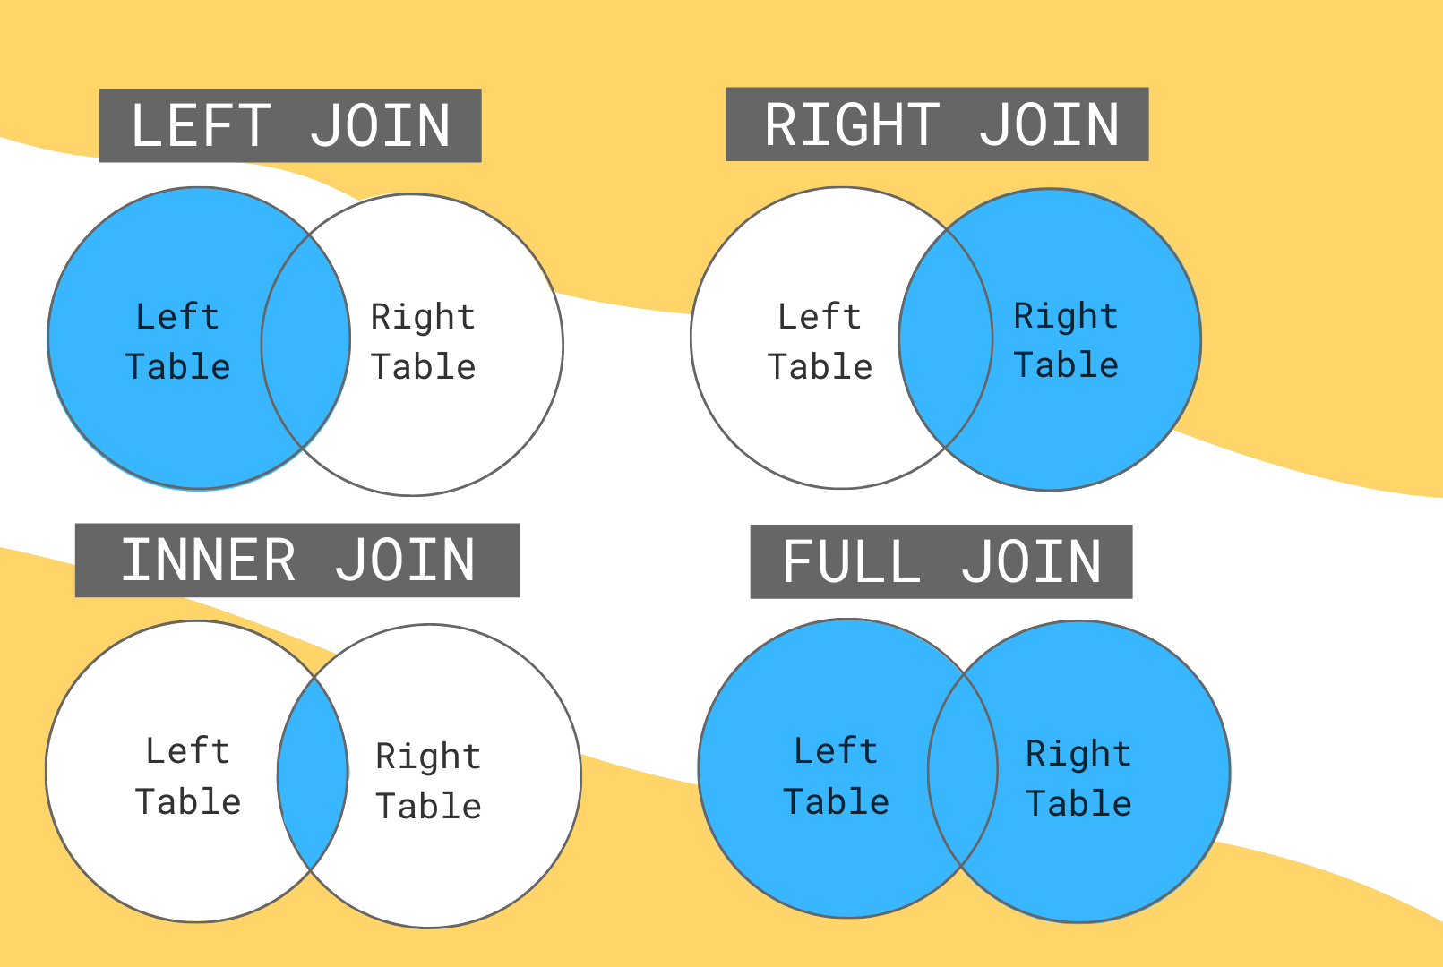
What are Joins
Join
JOINS in SQL are commands which are used to combine rows from two or more tables, based on a related column between those tables. There are predominantly used when a user is trying to extract data from tables which have one-to-many or many-to-many relationships between them.
Image Source: https://learnsql.com/blog/learn-and-practice-sql-joins/2.png
Notes:
Left (White Color space):
Title - Parent Topic
Subtitle - Subtopic 1
Body Text - Description in bullets
Right (Grey Color Space):
Body Text - Relevant image (with source)/code snippet
Put reference links in Speaker Notes
Reference:
https://www.tutorialspoint.com/internet_technologies/internet_overview.htm/

Slide 38
What are Joins
Types of Joins
There are mainly four types of joins that you need to understand. They are:
INNER JOIN
FULL JOIN
LEFT JOIN
RIGHT JOIN
Image Source: https://learnsql.com/blog/learn-and-practice-sql-joins/2.png
Notes:
Left (White Color space):
Title - Parent Topic
Subtitle - Subtopic 1
Body Text - Description in bullets
Right (Grey Color Space):
Body Text - Relevant image (with source)/code snippet
Put reference links in Speaker Notes
Reference:
https://www.tutorialspoint.com/internet_technologies/internet_overview.htm/

Slide 39
What are Joins
Types of Joins
There are mainly four types of joins that you need to understand. They are:
INNER JOIN
FULL JOIN
LEFT JOIN
RIGHT JOIN
Image Source: https://learnsql.com/blog/learn-and-practice-sql-joins/2.png
Notes:
Left (White Color space):
Title - Parent Topic
Subtitle - Subtopic 1
Body Text - Description in bullets
Right (Grey Color Space):
Body Text - Relevant image (with source)/code snippet
Put reference links in Speaker Notes
Reference:
https://www.tutorialspoint.com/internet_technologies/internet_overview.htm/

Slide 40
Employee Table
EmpID | EmpFname | EmpLname | Age | EmailID | PhoneNo | Address
1 | Vardhan | Kumar | 22 | vardy@abc.com | 9876543210 | Delhi
2 | Himani | Sharma | 32 | himani@abc.com | 9977554422 | Mumbai
3 | Aayushi | Shreshth | 24 | aayushi@abc.com | 9977555121 | Kolkata
4 | Hemanth | Sharma | 25 | hemanth@abc.com | 9876545666 | Bengaluru
5 | Swatee | Kapoor | 26 | swatee@abc.com | 9544567777 | Hyderabad
Image Source: https://learnsql.com/blog/learn-and-practice-sql-joins/2.png
Notes:
Left (White Color space):
Title - Parent Topic
Subtitle - Subtopic 1
Body Text - Description in bullets
Right (Grey Color Space):
Body Text - Relevant image (with source)/code snippet
Put reference links in Speaker Notes
Reference:
https://www.tutorialspoint.com/internet_technologies/internet_overview.htm/

Slide 41
Project Table
ProjectID | EmpID | ClientID | ProjectName | ProjectStartDate
111 | 1 | 3 | Project1 | 2019-04-21
222 | 2 | 1 | Project2 | 2019-02-12
333 | 3 | 5 | Project3 | 2019-01-10
444 | 3 | 2 | Project4 | 2019-04-16
555 | 5 | 4 | Project5 | 2019-05-23
666 | 9 | 1 | Project6 | 2019-01-12
777 | 7 | 2 | Project7 | 2019-07-25
888 | 8 | 3 | Project8 | 2019-08-20
Image Source: https://learnsql.com/blog/learn-and-practice-sql-joins/2.png
Notes:
Left (White Color space):
Title - Parent Topic
Subtitle - Subtopic 1
Body Text - Description in bullets
Right (Grey Color Space):
Body Text - Relevant image (with source)/code snippet
Put reference links in Speaker Notes
Reference:
https://www.tutorialspoint.com/internet_technologies/internet_overview.htm/

Slide 42
Client Table
ClientID | ClientFname | ClientLname | Age | ClientEmailID | PhoneNo | Address | EmpID
1 | Susan | Smith | 30 | susan@adn.com | 9765411231 | Kolkata | 3
2 | Mois | Ali | 27 | mois@jsq.com | 9876543561 | Kolkata | 3
3 | Soma | Paul | 22 | soma@wja.com | 9966332211 | Delhi | 1
4 | Zainab | Daginawala | 40 | zainab@qkq.com | 9955884422 | Hyderabad | 5
5 | Bhaskar | Reddy | 32 | bhaskar@xyz.com | 9636963269 | Mumbai | 2
Image Source: https://learnsql.com/blog/learn-and-practice-sql-joins/2.png
Notes:
Left (White Color space):
Title - Parent Topic
Subtitle - Subtopic 1
Body Text - Description in bullets
Right (Grey Color Space):
Body Text - Relevant image (with source)/code snippet
Put reference links in Speaker Notes
Reference:
https://www.tutorialspoint.com/internet_technologies/internet_overview.htm/

Slide 43
What are Joins
SELECT Employee.EmpID, Employee.EmpFname, Employee.EmpLname, Projects.ProjectID, Projects.ProjectName
FROM Employee
INNER JOIN Projects ON Employee.EmpID=Projects.EmpID;
OUTPUT
INNER JOIN
EmpID | EmpFname | EmpLname | ProjectID | ProjectName
1 | Vardhan | Kumar | 111 | Project1
2 | Himani | Sharma | 222 | Project2
3 | Aayushi | Shreshth | 333 | Project3
3 | Aayushi | Shreshth | 444 | Project4
5 | Swatee | Kapoor | 555 | Project5
This type of join returns those records which have matching values in both tables. So, if you perform an INNER join operation between the Employee table and the Projects table, all the tuples which have matching values in both the tables will be given as output.
Syntax:
SELECT Table1.Column1,Table1.Column2,Table2.Column1,.... FROM Table1 INNER JOIN Table2 ON Table1.MatchingColumnName = Table2.MatchingColumnName;
Image Source: https://www.edureka.co/blog/sql-joins-types
Notes:
Left (White Color space):
Title - Parent Topic
Subtitle - Subtopic 1
Body Text - Description in bullets
Right (Grey Color Space):
Body Text - Relevant image (with source)/code snippet
Put reference links in Speaker Notes
Reference:
https://www.tutorialspoint.com/internet_technologies/internet_overview.htm/

Slide 44
What are Joins
SELECT Employee.EmpFname, Employee.EmpLname, Projects.ProjectID
FROM Employee
FULL JOIN Projects
ON Employee.EmpID = Projects.EmpID;
OUTPUT
FULL JOIN
EmpFname | EmpLname | ProjectID
Vardhan | Kumar | 111
Himani | Sharma | 222
Aayushi | Shreshth | 333
Aayushi | Shreshth | 444
Hemanth | Sharma | NULL
Swatee | Kapoor | 555
NULL | NULL | 666
NULL | NULL | 777
NULL | NULL | 888
Full Join or the Full Outer Join returns all those records which either have a match in the left(Table1) or the right(Table2) table.
Syntax:
SELECT Table1.Column1,Table1.Column2,Table2.Column1,.... FROM Table1 FULL JOIN Table2 ON Table1.MatchingColumnName = Table2.MatchingColumnName;
Image Source: https://www.edureka.co/blog/sql-joins-types
Notes:
Left (White Color space):
Title - Parent Topic
Subtitle - Subtopic 1
Body Text - Description in bullets
Right (Grey Color Space):
Body Text - Relevant image (with source)/code snippet
Put reference links in Speaker Notes
Reference:
https://www.tutorialspoint.com/internet_technologies/internet_overview.htm/

Slide 45
What are Joins
SELECT Employee.EmpFname, Employee.EmpLname, Projects.ProjectID, Projects.ProjectName
FROM Employee
LEFT JOIN
ON Employee.EmpID = Projects.EmpID ;
OUTPUT
LEFT JOIN
EmpFname | EmpLname | ProjectID | ProjectName
Vardhan | Kumar | 111 | Project1
Himani | Sharma | 222 | Project2
Aayushi | Shreshth | 333 | Project3
Aayushi | Shreshth | 444 | Project4
Swatee | Kapoor | 555 | Project5
Hemanth | Sharma | NULL | NULL
The LEFT JOIN or the LEFT OUTER JOIN returns all the records from the left table and also those records which satisfy a condition from the right table. Also, for the records having no matching values in the right table, the output or the result-set will contain the NULL values.
Syntax:
SELECT Table1.Column1,Table1.Column2,Table2.Column1,.... FROM Table1 LEFT JOIN Table2 ON Table1.MatchingColumnName = Table2.MatchingColumnName;
Image Source: https://www.edureka.co/blog/sql-joins-types
Notes:
Left (White Color space):
Title - Parent Topic
Subtitle - Subtopic 1
Body Text - Description in bullets
Right (Grey Color Space):
Body Text - Relevant image (with source)/code snippet
Put reference links in Speaker Notes
Reference:
https://www.tutorialspoint.com/internet_technologies/internet_overview.htm/

Slide 46
What are Joins
SELECT Employee.EmpFname, Employee.EmpLname, Projects.ProjectID, Projects.ProjectName
FROM Employee
RIGHT JOIN
ON Employee.EmpID = Projects.EmpID;
OUTPUT
RIGHT JOIN
EmpFname | EmpLname | ProjectID | ProjectName
Vardhan | Kumar | 111 | Project1
Himani | Sharma | 222 | Project2
Aayushi | Shreshth | 333 | Project3
Aayushi | Shreshth | 444 | Project4
Swatee | Kapoor | 555 | Project5
NULL | NULL | 666 | Project6
NULL | NULL | 777 | Project7
NULL | NULL | 888 | Project8
The RIGHT JOIN or the RIGHT OUTER JOIN returns all the records from the right table and also those records which satisfy a condition from the left table. Also, for the records having no matching values in the left table, the output or the result-set will contain the NULL values.
Syntax:
SELECT Table1.Column1,Table1.Column2,Table2.Column1,.... FROM Table1 RIGHT JOIN Table2 ON Table1.MatchingColumnName = Table2.MatchingColumnName;
Image Source: https://www.edureka.co/blog/sql-joins-types
Notes:
Left (White Color space):
Title - Parent Topic
Subtitle - Subtopic 1
Body Text - Description in bullets
Right (Grey Color Space):
Body Text - Relevant image (with source)/code snippet
Put reference links in Speaker Notes
Reference:
https://www.tutorialspoint.com/internet_technologies/internet_overview.htm/

